Slide 1
Midterm Review
COS 461 - Precept 5

Slide 2
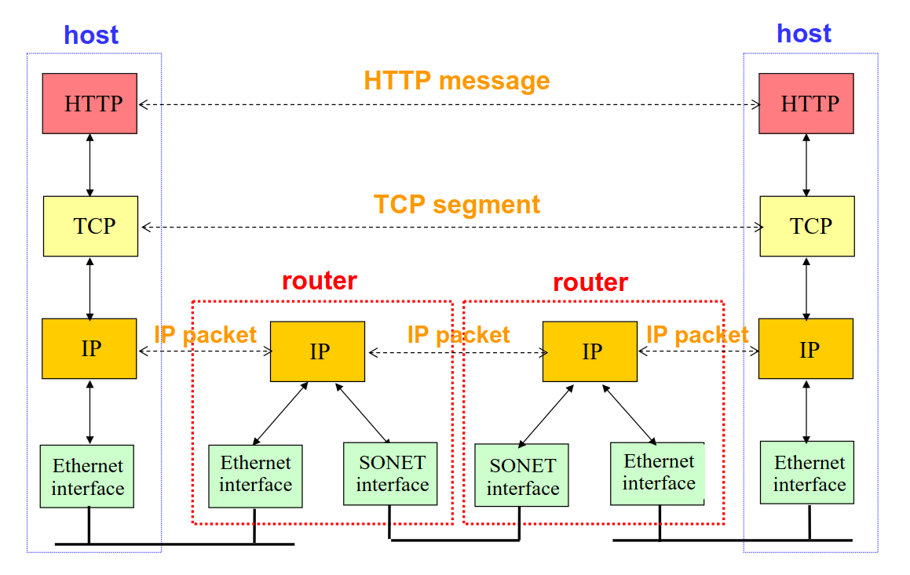
What have we learned?
Network Organized into Layers

Slide 3
Physical Layer
Encoding bits on physical medium
Examples: Voltages on an ethernet cable or PSK on a wireless link
We haven’t talked about this much
Repeaters

Slide 4
2. Link Layer
Encoding chunks of data (“frames”) and transmitting them on the physical link
Need to detect/avoid collisions (CSMA/CD)
Check delivery (ACKs)
Error correction (CRC)
Host naming: MAC Addresses
Identification protocols: DHCP and ARP
Forwarding: Exact match
Switches

Slide 5
3. Network Layer
End-to-end unreliable message delivery between hosts not physically connected
Packet switching versus circuit switching
Router design
Naming: IP addresses
Subnets
Hierarchical addressing
CIDR
Error Correction: IP Checksum
Forwarding: Longest Prefix Match
Router Queuing, VOQ, Bufferbloat
Routing algorithms: Distance-Vector, Link-state
Middleboxes

Slide 6
4. Transport Layer
End-to-end reliable byte streams connecting processes on two different machines
TCP
Logical connections established with SYN/SYN-ACK
Congestion Control: AIMD, Timeouts versus 3-ACKs, Phase plots, Non-loss-based CC
Error correction: Hamming Codes, Matrix-based Parity, etc.
Used for most network traffic, where receiving message bit-perfect is necessary
Example: Transactions for an online bank
UDP
Unreliable, unacknowledged delivery of Datagrams
No congestion control by default, WebRTC uses GCC
Useful for streaming data, where speed matters more than correctness
Example: Video conferencing

Slide 7
Application Layer
Program-specific behavior using the transport layer’s reliable byte stream
Examples: HTTP, SMTP, SSH, FTP
We haven’t talked much about this

Slide 8
What should you study?
All material from Lectures 1-10, Precepts 1-4, Assignments 1-2 is fair game
Algorithms/Protocols
Work through examples, understand the mechanics
Understand strengths, weaknesses, and tradeoffs
Reason about changes to protocols and their effects
Layer behavior
What happens at which layer
What abstraction does each layer provide?
What algorithms do each layer’s protocols use to provide this abstraction?
Topics from your assignments
Sockets, bufferbloat, reasoning about performance

